Slide 1
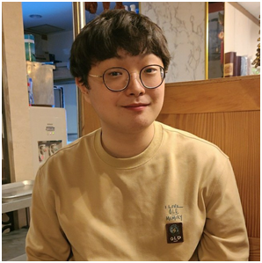
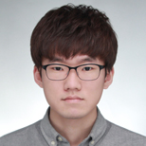
Compact Decomposition of Irregular Tensors for Data Compression: From Sparse to Dense to High-order Tensors
Taehyung Kwon
Jihoon Ko
Jinhong Jung
Jun-Gi Jang
Kijung Shin
Notes:
Hello, I am Taehyung from KAIST. It is an honor to present my paper at KDD. The title of our research track paper is ’Compact decomposition of irregular tensors for data compression: from sparse to dense to high-order tensors’. This is a joint work with Jihoon, Jinhong, Jun-Gi, and my advisor Kijung.

Slide 2
Tensor
A (regular) tensor is a multi-dimensional array.
In this work, we assume tensors of real values.
-2
7
11
-2
-2
7
11
19
22
-8
19
19
22
-8
4
16
24
4
4
16
24
Vector
(1-order tensor)
Matrix
(2-order tensor)
Tensor
(3-order tensor)
Notes:
A regular tensor is a multi-dimensional array. A vector is a 1-order tensor, a matrix is a 2-order tensor, and tensors in general can have higher orders. In this work, we assume tensors of real values.

Slide 3
Irregular tensor
A (3-order) irregular tensor is a collection of matrices with varying row counts.
2nd Order
3rd Order
1st Order
Notes:
An irregular tensor, especially a 3-order one, is a collection of matrices with varying numbers of rows. In this example, the first mode indices indicate rows of each matrix, the second mode indices indicate its columns, and the final mode indices indicate different matrices whose numbers of rows vary.

Slide 4
Various real-world data are irregular tensors
User A
User B
User C
Patient A
Patient B
Patient C
Item
Diagnosis
User
Patient
User-item click history
Electronic health record (EHR)
Session
Visit
More than 140 billion entries
Notes:
Various real-world data can be represented as irregular tensors. For instance, user-item click history which records how many times each user clicks on each item during each session can be represented as an irregular tensor. In addition, electronic health records, which store the diagnoses for each patient on each visit can also be represented as an irregular tensor. Such real-world tensors can be enormous, with hundreds of billions of entries, requiring significant storage costs. Thus, compression is required.

Slide 5
Problem definition
Lossy compression of an irregular tensor.
Given: an irregular tensor ${\left\{𝓧_{k}\right\}}_{k=1}^{K}$
Find: the compressed data $D$
To minimize: (1) the size of $D$ and the approximation error $\sum_{k=1}^{K}{{\left\|𝓧_{k}−{\tilde{𝓧}}_{k}\right\|}_{F}^{2}}$
where ${\left\{{\tilde{𝓧}}_{k}\right\}}_{k=1}^{K}$is the approximation of the input tensor.
$${\left\{{\tilde{𝓧}}_{k}\right\}}_{k=1}^{K}$$
$${\left\{𝓧_{k}\right\}}_{k=1}^{K}$$
$$D$$
Notes:
The problem we want to tackle in this paper is the lossy compression of an irregular tensor. Given an irregular tensor, we aim to find the compressed data, while minimizing the size of data and the approximation errors. Note that tilde X denotes the approximation of the input tensor.

Slide 6
Outline
Introduction.
Preliminaries.
Proposed method.
Experiments.
Conclusion.
Notes:
Now I will present the preliminaries of the paper.

Slide 7
Previous lossy compression: PARAFAC2
PARAFAC2 approximates an irregular tensor with the products of factor matrices.
1st mode
factor matrices
3rd mode
factor matrices
2nd mode
factor matrix
$$≈$$
Shared
$$≈$$
Matrices
Approximation ${\left\{{\tilde{𝓧}}_{k}\right\}}_{k=1}^{K}$ of matrices in ${\left\{𝓧_{k}\right\}}_{k=1}^{K}$
Input irregular tensor ${\left\{𝓧_{k}\right\}}_{k=1}^{K}$
Approximation ${\left\{{\tilde{𝓧}}_{k}\right\}}_{k=1}^{K}$ of matrices in ${\left\{𝓧_{k}\right\}}_{k=1}^{K}$
Matrices in ${\left\{𝓧_{k}\right\}}_{k=1}^{K}$
Notes:
PARAFAC2 is a well-known method applicable to the lossy compression of irregular tensors. It approximates each matrix in the input irregular tensor with the products of the factor matrices. Note that rectangles indicate matrices. Here, the first matrix in the products is the 1st mode factor matrix, the second diagonal matrix is built from the 3rd mode factor matrix, and the final matrix is the 2nd mode factor matrix. Note that the 2nd mode factor matrix, which is colored in purple, is shared across different slices of the irregular tensor. But there are different 1st mode factor matrices depending on the third mode indices.

Slide 8
Previous lossy compression: PARAFAC2
PARAFAC2 approximates an irregular tensor with the products of factor matrices.
1st mode
factor matrices
3rd mode
factor matrices
2nd mode
factor matrix
$$≈$$
Input irregular tensor
Approximation of
the input tensor
Notes:
From a tensor perspective, PARAFAC2 can be depicted as shown.

Slide 9
Previous lossy compression: PARAFAC2
PARAFAC2 approximates an irregular tensor with the products of factor matrices.
1st mode
factor matrices
3rd mode
factor matrices
2nd mode
factor matrix
$$≈$$
Input irregular tensor
Approximation of
the input tensor
Notes:
If the number of matrices in the input irregular tensor increases, so does the number of the 1st mode factor matrices.

Slide 10
Previous lossy compression: PARAFAC2
Factor matrices can be stored instead of the input irregular tensor.
That is, factor matrices can be regarded as the compressed output.
$$≈$$
Input irregular tensor
Approximation of
the input tensor
Notes:
From a compression perspective, aforementioned factor matrices can be stored as the compressed output instead of the input irregular tensor.

Slide 11
Outline
Introduction.
Preliminaries.
Proposed method.
Experiments.
Conclusion.
Notes:
Let’s move on to the proposed method of the paper.

Slide 12
Overview of Light-IT and Light-IT⁺⁺
We propose Light-IT and Light-IT⁺⁺, lossy compression algorithms for irregular tensors, built upon PARAFAC2.
Q1. Compactness: How can we compress irregular tensors compactly?
Q2. Expressiveness: How can we increase the expression power of PARAFAC2?
Q3. How can we efficiently compress sparse irregular tensors?
Q4. How can we compress higher-order irregular tensors?
Notes:
We proposed Light-IT and Light-IT++, lossy compression algorithms for irregular tensors, built upon PARAFAC2. We find several challenges while developing our algorithms. The first question is, compactness; how can we compress irregular tensors compactly. Second, expressiveness; how can we increase the expression power of PARAFAC2. Third, how can we efficiently compress sparse irregular tensors. Finally, how can we compress higher-order irregular tensors.

Slide 13
Limited compression ability of PARAFAC2
PARAFAC2 gives a first mode matrix for each slice of an irregular tensor.
Bottleneck: saving all the 1st mode factor matrices is expensive.
Q1 .How can we make the compression result more compact?
$$≈$$
Shared
$$≈$$
Approximation of
the input tensor
Input irregular tensor
Notes:
From now on, an input irregular tensor will be located in the right side for the ease of visualization. PARAFAC2 gives a first mode matrix for each slice of an irregular tensor. Here, saving all the 1st mode factor matrices becomes a memory bottleneck. How can we make the compression result more compact?

Slide 14
A1. Vocabulary-based compression (Light-IT)
We use a single vocabulary matrix $V$ shared by all 1st mode factor matrices.
The 1st mode factor matrix for each slice is constructed from $V$ by mappings.
Vocabulary
matrix $V$
1st mode
factor matrices
$$≈$$
Shared
$$≈$$
Mappings
(learnable)
Approximation of
the input tensor
Input irregular tensor
Notes:
We use a single learnable vocabulary matrix instead of multiple different 1st mode factor matrices. Then, the first mode factor matrix for each slice is constructed from the vocabulary matrix by mappings. We called this method as Light-IT and the approximation process of Light-IT is the same as PARAFAC2.

Slide 15
Compression results using Light-IT
Only a single factor matrix per mode is required.
Mappings are further compressed by Huffman encoding.
1st mode factor matrix
2nd mode
factor matrix
3rd mode
factor matrices
1
3
5
1
2
3
5
4
1st mode factor matrices in PARAFAC2
(not required in Light-IT)
Vocabular
matrix
Mappings
(integer arrays)
Notes:
The compressed results of Light-IT are given as follows. Unlike PARAFAC2 decomposition, only a single factor matrix per mode is required. Mappings between the rows of the vocabulary matrix and the rows of the 1st mode factor matrices are further compressed by Huffman encoding since they are integer values.

Slide 16
Limited expressional ability of PARAFAC2 (and Light-IT)
Each entry is approximated by the (weighted) product of feature vectors.
It fails to capture the relationships between different features.
Latent feature vectors
Target entry
$$≈$$
Feature weights
Shared
$$≈$$
Approximation of
the input tensor
Input irregular tensor
Notes:
Still, the expression abilities of PARAFAC2 and Light-IT can be limited. Each entry of an irregular tensor is approximated by the weighted products of feature vectors. It fails to capture the relationships between different features.

Slide 17
A2. Extension with a core tensor (Light-IT⁺⁺)
Incorporate a core tensor to capture relationships between different features, enhancing the expressiveness of the model.
Core tensor
(learnable)
Shared
Shared
Light-IT
Light-IT⁺⁺
Notes:
Light-IT++ extends Light-IT with a core tensor. It incorporates a core tensor into approximations to capture relationships between different features, enhancing the expressiveness of the model. As you can see in the right figure, Light-IT++ considers relationships between different features when approximating an entry of the irregular tensor.

Slide 18
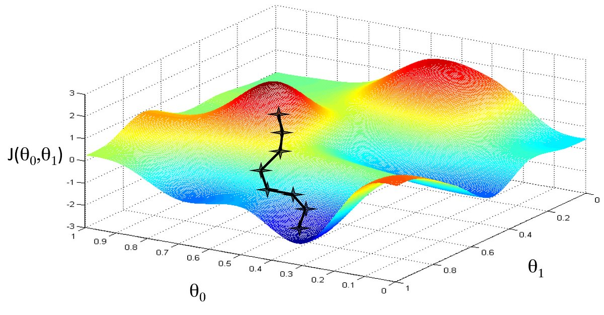
Training of Light-IT and Light-IT⁺⁺
Light-IT: gradient descent to minimize the squared error
Mappings can be also made differentiable*
Light-IT⁺⁺: alternating least square (ALS) for sequential updates
Mappings are fixed to those from Light-IT.
2nd mode
factor matrix
3rd mode
factor matrix
Core tensor
Vocabulary
matrix
* Differentiable product quantization for end-to-end embedding compression. In ICML 2020.
Notes:
In the case of Light-IT, we used gradient descents for updating the factor matrices with the loss as a squared error. Note that mappings can be also made differentiable. The mappings in Light-IT++ is fixed from that obtained from Light-IT. We used Alternating Least Square (ALS) for updating the factor matrices and a core tensor one by one.

Slide 19
A3. Sparse design
Exploit the sparsity of sparse tensors for the efficient computation.
E.g.) complexity of loss computation in Light-IT:
Naïve computation ∝ all entry count.
Efficient computation ∝ non-zero entry count.
Key idea: compute the losses for zero entries efficiently in a closed form
$$∝$$
Time
complexity
$$\# Nonzero$$
$$entries$$
Notes:
Many real-world irregular tensors are sparse with most entries being zero. We exploit the sparsity of such sparse tensors for the efficient computation. For instance, let’s consider the case of computing the loss of Light-IT. Naïve computation is computing loss for each entry, which takes time proportional to the number of entries in the tensor. The key idea is to compute the losses for zero-entries in a closed-from. Then, we only need to compute the losses for non-zero entries, which takes time proportional to the number of non-zero entries in the irregular tensor.

Slide 20
A4. Higher-order design
Our methods are applicable to irregular tensors of any order.
Key idea: matricize the input irregular tensor and its approximation.
Mappings
(integer arrays)
3rd order
4th order
1
3
5
1
2
3
5
4
2nd order
1st order
Notes:
Our methods are applicable to irregular tensors of any order. This figure shows the compression results for a 4-order irregular tensor. There are a single factor matrix for each mode, and integer mappings which will be futher compressed by Huffman encoding. For optimization, we carefully matricize the input irregular tensor and its approximation.

Slide 21
Outline
Introduction.
Preliminaries.
Proposed method.
Experiments.
Conclusion.
Notes:
Now, it’s time to check ours methods’ empirical superiority in terms of compression.

Slide 22
Experimental settings: Datasets
Used 6 public real-world datasets.
Four 3-order and two 4-order irregular tensors.
Four sparse and two dense irregular tensors.
Electronic hospital records
Email data
User-interaction data
Stock data
Notes:
We used 6 real-world public datasets. Among them, four are three dimensional and two are four dimensional. In addition, there are four sparse and two dense irregular tensors. The datasets are built with electronic hospital record (so called EHR), email data, user-interaction data, and stock data.

Slide 23
Experimental settings: Baselines
We used lossy-compression baselines.
Methods for 3-order dense irregular tensors.
PARAFAC2-ALS, RD-ALS, DPar2, and HyTuck2.
Methods for 3-order sparse irregular tensors.
COPA, SPARTan, and REPAIR.
A method for 4-order dense irregular tensors.
BTD2.
Notes:
We used 8 lossy compression methods for irregular tensors as baselines. There are 4 methods for 3-order dense irregular tensors, 3 methods for 3-order sparse irregular tensors, and a single method for 4-order dense irregular tensors.

Slide 24
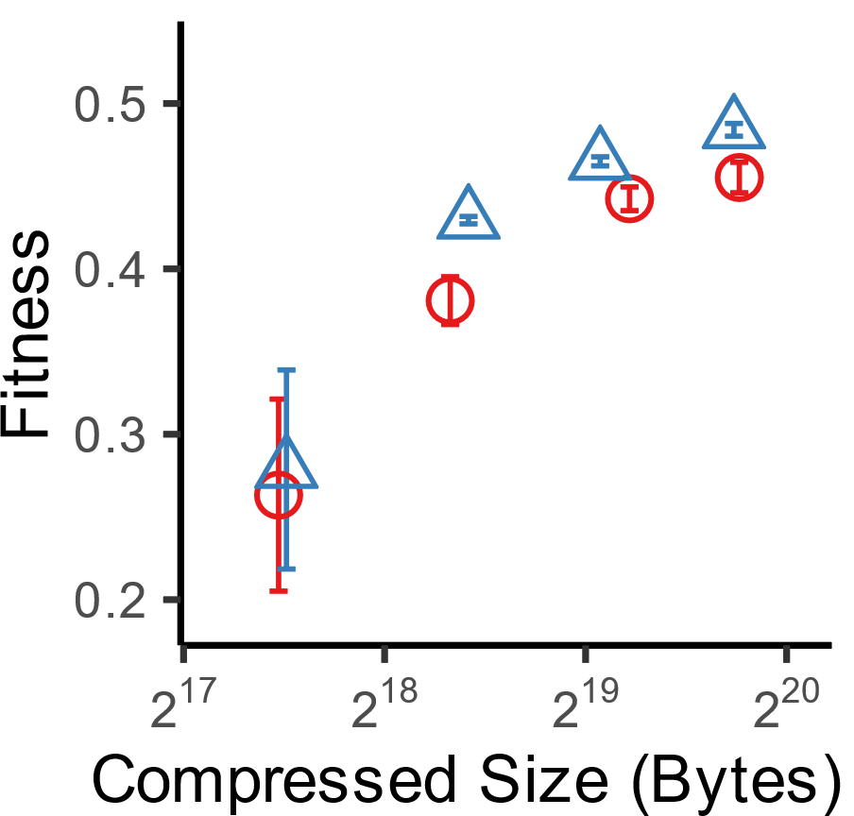
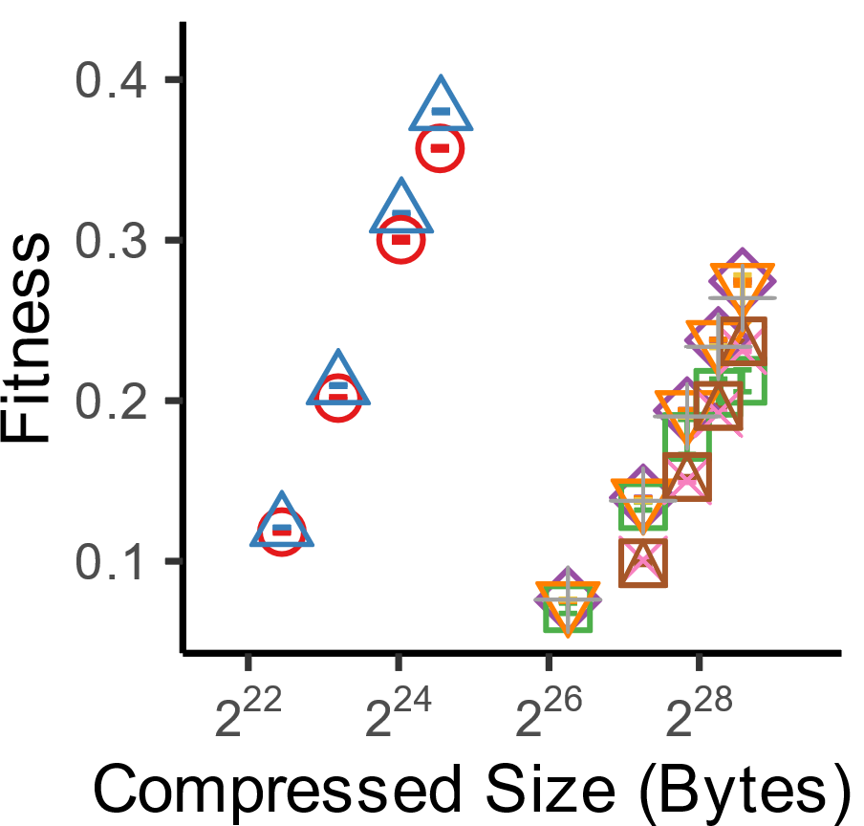
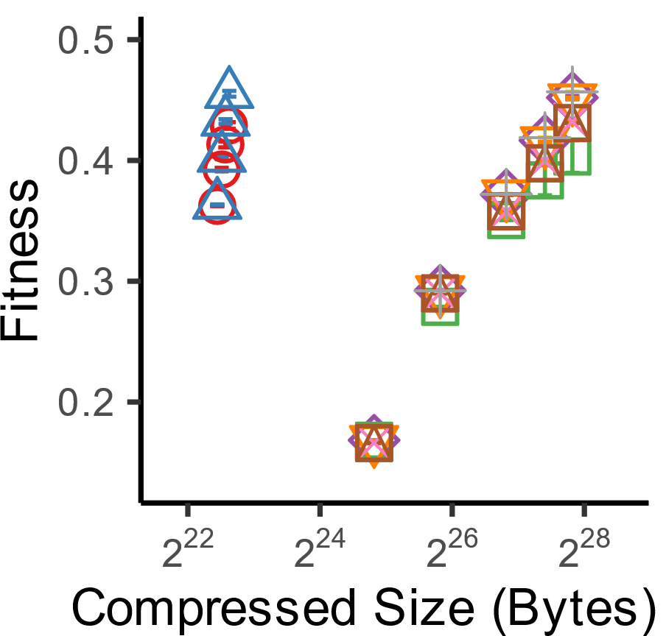
Our methods are concise and precise
The compressed outputs of our methods are up to 37x smaller.
Our methods show up to 5x better accuracy.
Light-IT (Proposed) Light-IT⁺⁺ (Proposed) SPARTan COPA
PARAFAC2-ALS DPar2 RD-ALS REPAIR HyTuck2 BTD2
ours
ours
36.55x
5x
24.95x
2.7x
O.O.M
CMS
Korea-stock
Enron
Notes:
Our methods are concise and precise. As you can see, the results of our methods are located in the top-left corner. The closer the point is to the top-left corner, the better the accuracy-compression size trade-off the corresponding method shows. The compressed outputs of our methods are up to 37 times smaller and our methods show up to 5 times better accuracy. Note that BTD2 ran out of memory when running on a sparse 4-order irregular tensor.

Slide 25
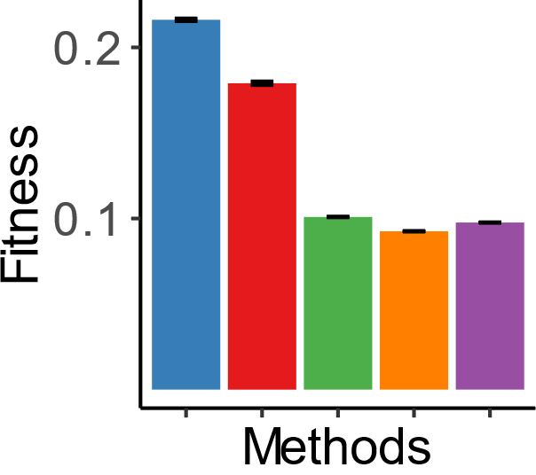
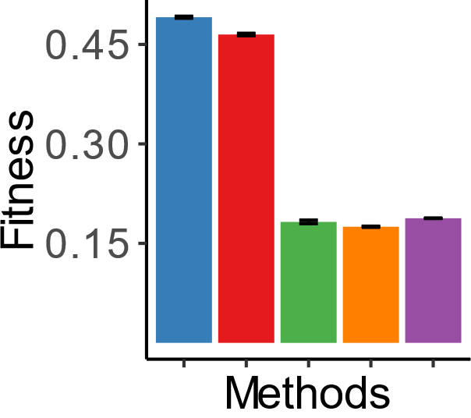
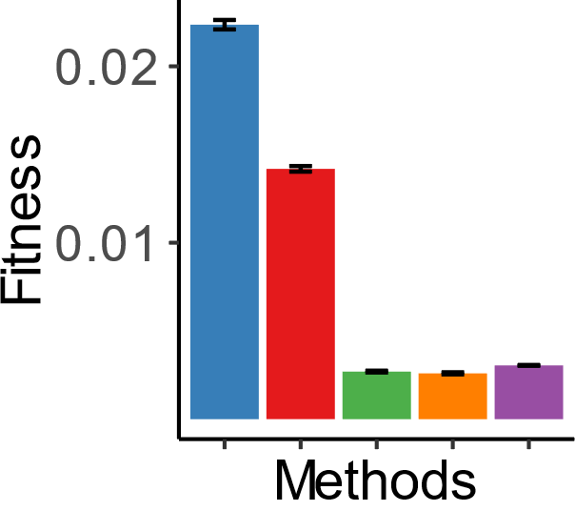
All components of our methods are useful
(1) vocabulary-based compression and (2) extension with a core tensor are effective for compression.
Light-IT (Proposed) Light-IT⁺⁺ (Proposed)
Light-IT-L CP Tucker
Light-IT-L: Light-IT variant mapping the i-th row of a slice to the i-th row of the shared matrix.
CP: CP decomposition.
Tucker: Tucker decomposition.
MIMIC-III
US-stock
Delicious
Datasets
Notes:
All components of our methods are useful. Here, Light-IT-L is a variant of Light-IT without learning mappings. That is, it maps the i-th row of a slice to the i-th row of the shared matrix . CP is CP decomposition, and tucker is tucker decomposition. Our ideas of vocabulary-based compression and extension with a core tensor are effective for compression, as you can see in the arrows colored in yellow and sky-blue.

Slide 26
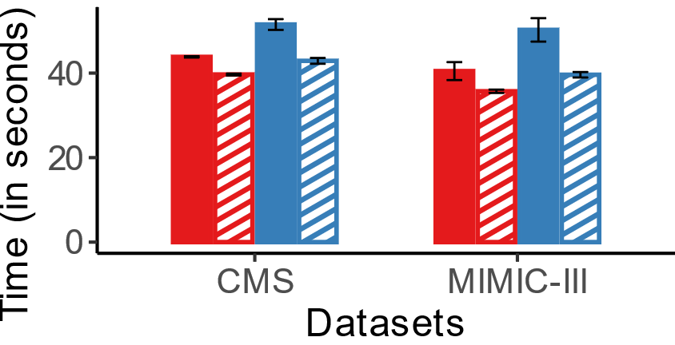
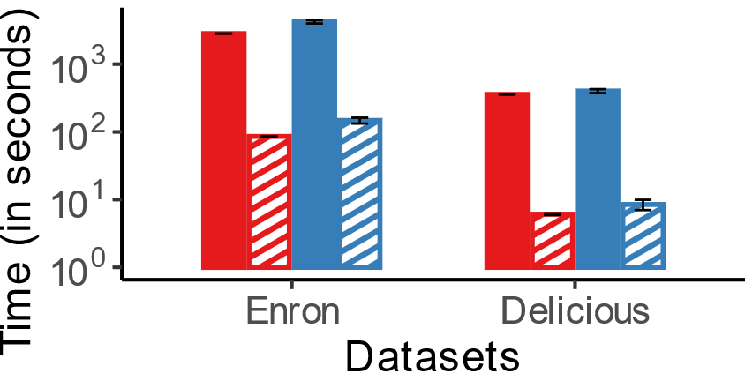
Our methods for sparse tensors are faster
For sparse irregular tensors, the sparse versions of our methods are faster than their dense versions.
Light-IT Light-IT for sparse tensors Light-IT⁺⁺ Light-IT⁺⁺ for spare tensors
3-order irregular tensors
4-order irregular tensors
Notes:
For sparse irregular tensors, the sparse versions of our methods are faster than their dense versions. Here the bar with dashed lines indicates the running time of our methods for sparse tensors. Red bars indicate Light-IT and blue bars indicate Light-IT++. As you can see, the sparse versions are faster especially in higher-order tensors.

Slide 27
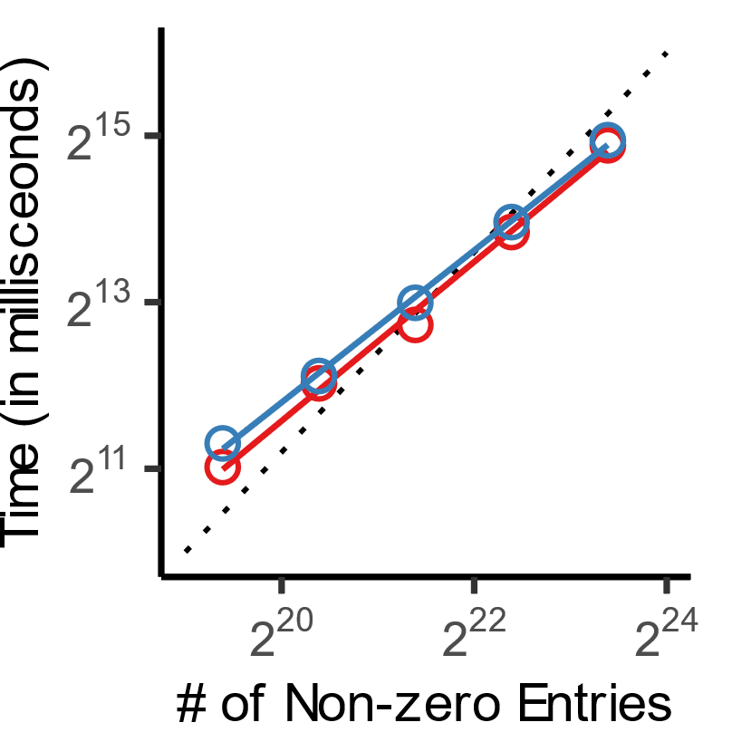
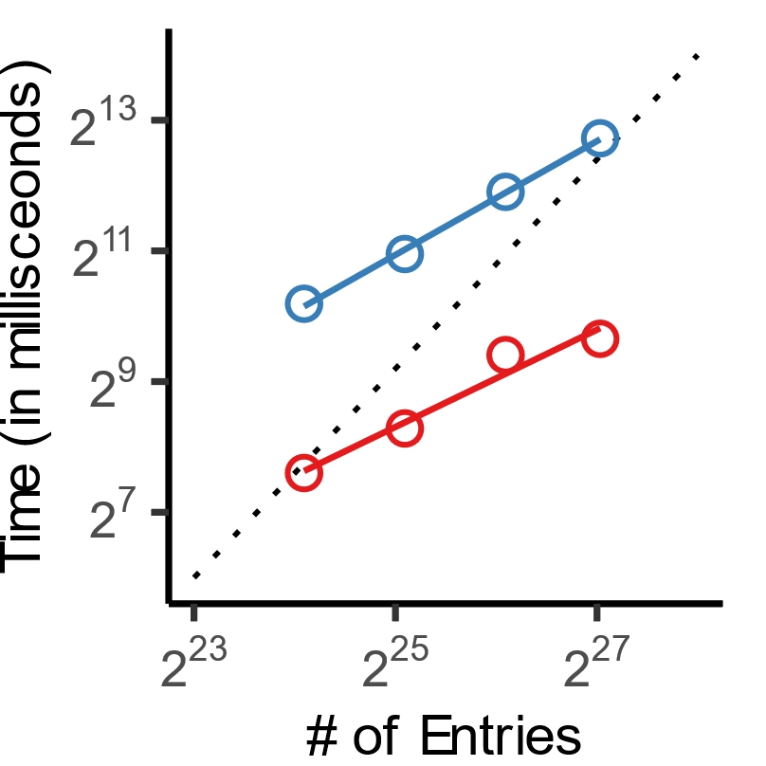
Our methods are scalable
Compression time of our methods is linear in the number of (non-zero) entries.
Light-IT
Light-IT⁺⁺
3-order sparse tensors
3-order dense tensors
Notes:
This figure shows how training time for a single epoch changes depending on the number of entries or non-zero entries in the tensor. Red line indicates Light-IT and blue line indicates Light-IT++. As you can see in the figures, compression time of our methods is linear in the number of non-zero entries or entries in the tensor. Therefore, our methods are scalable.

Slide 28
Total compression time
Our methods tend to be slower than most competitors.
However, our methods took at most 1.1 hours for all considered datasets.
Light-IT (Proposed) Light-IT⁺⁺ (Proposed) SPARTan COPA
PARAFAC2-ALS DPar2 RD-ALS REPAIR HyTuck2
Notes:
Our methods tend to be slower than most competitors. The main cause is the gradient descent process used during the training of Light-IT. However, our methods are still fast enough, taking at most 1.1 hours for all considered datasets.

Slide 29
Outline
Introduction.
Preliminaries.
Proposed method.
Experiments.
Conclusion.
Notes:
I will finish my presentation with conclusions.

Slide 30
Conclusions
We propose Light-IT and Light-IT⁺⁺, lossy compression algorithms for irregular tensors, built upon PARAFAC2.
Compact and Accurate
Scalable
Versatile
Light-IT
Reconstruction accuracy
Compression time
Competitors
$Θ$(# of entries)
Compressed size
# of entries
Notes:
In this work, we propose Light-IT and Light-IT++ for lossy compression of irregular tensors. They are compact, accurate, and scalable, and versatile, being applicable to high-order tensors and sparse tensors.

Slide 31
Compact Decomposition of Irregular Tensors for Data Compression: From Sparse to Dense to High-order Tensors
Taehyung Kwon
Jihoon Ko
Jinhong Jung
Jun-Gi Jang
Kijung Shin
Notes:
Thank you for listening to my presentation. Please check out our paper for more details. The links for code and datasets are available in the paper.

